Slide 1
Report out: Lobbyst4America

Slide 2
About
The project is in collaboration with Lobbyst4America
The goal is to analyse the congressional tweets in order to understand key topics, members and relationships within Congress.
These insights will help the company focus their efforts.

Slide 3
Contents
Review of Questions to Answer / Hypotheses / Approach
Discuss Technical Challenges
Detail: Entity Relationship Diagram (ERD)
Initial Findings
Deeper Analysis
Hypotheses Results

Slide 4
SECTION 1: Questions to Answer
Who are the most retweeted / mentioned people?
This can help understand what relationships are between congressmen
It can also show who is the most popular on the platform.
What are the topics that are most discussed?
This shows what they talk about the most.
Shows if there is any particular focus on a topic.
What is the “sentiment” of what is being discussed?
Are the tweets positive or negative?
Is there any difference at different periods of time?

Slide 5
SECTION 1: Initial Hypothesis
Most likely the top influential person for the last few years is Donald Trump
He is the president of the USA and is quite active in the platform.
Will show up easily in RTs and mentions.
I believe the topics they will discuss the most are immigration and economy.
Topics always on the news.
The sentiment will be neutral for the most part with some negative skew to the negative.
Primarily because there has been a big split in politians view between the parties in recent years.

Slide 6
SECTION 1: Data Analysis Approach
I will be looking at frequency metrics
For mentions
For RTs
Etc.
Will also look at word counts / frequencies
For topic analysis
For sentiment analysis

Slide 7
SECTION 2: Technical Challenges
Encountered challenges with opening the large dataset with pandas. However, after splitting the load in chunks and finding which columns were useful for the analysis the data size was reduced 84%.
Limitations of Pandasql made the running slow.

Slide 8
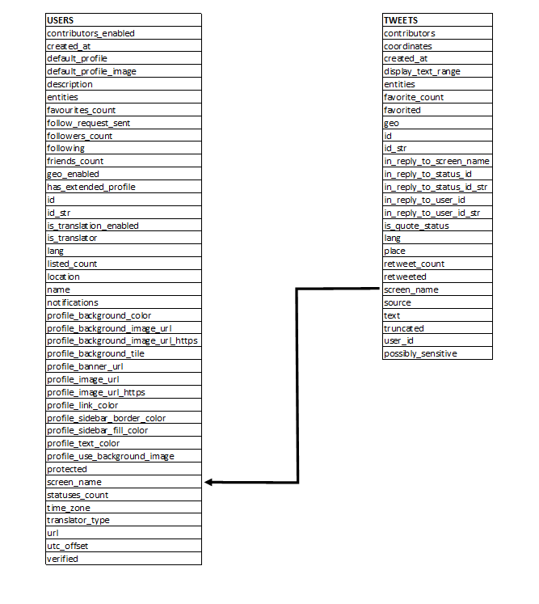
SECTION 3: Entity Relationship Diagram (ERD)

Slide 9
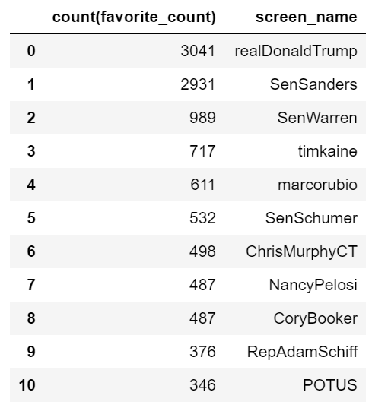
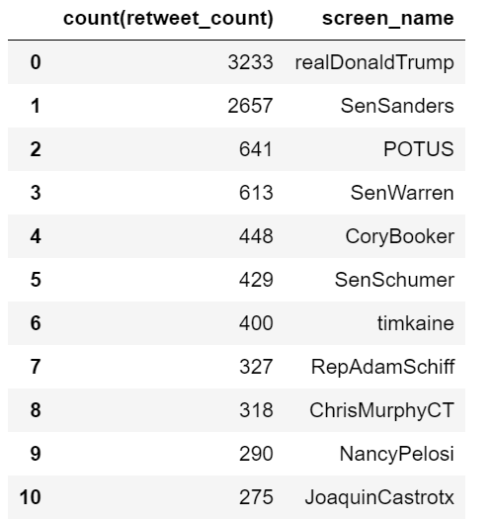
SECTION 4: Initial Findings
The initial hypothesis that Donald Trump would be the most influential person in the platform is confirmed looking at the top RTs and mentions.
Ben Sanders was on sencond possition on both stats, but thereafters there does not seem to be a big correlation. This needs further investigation.

Slide 10
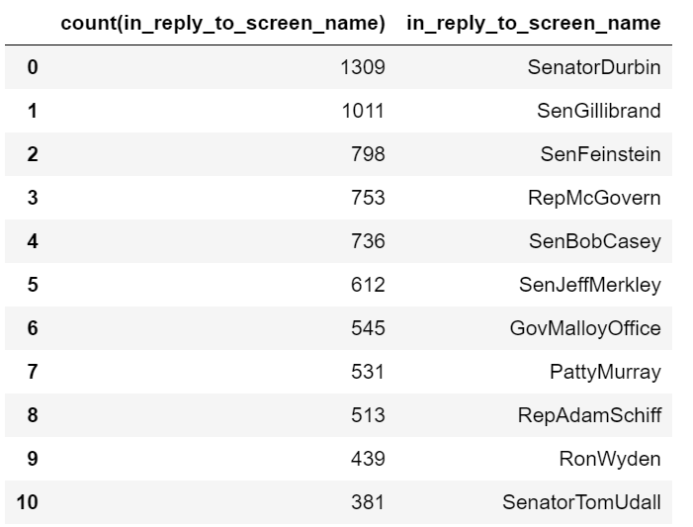
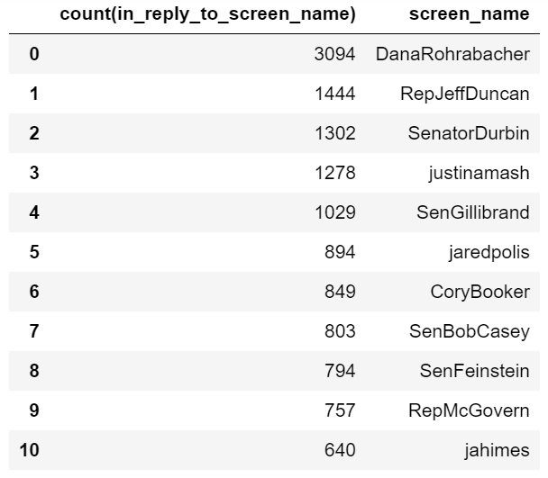
SECTION 4: Initial Findings
When looking at the person most influential from the list of members in the database the results are very different.
SenatorDurbin seems to be the person that is being replied the most from other congressmen
DanaRohrabacher is the most active in replying to other congressmen tweets.

Slide 11
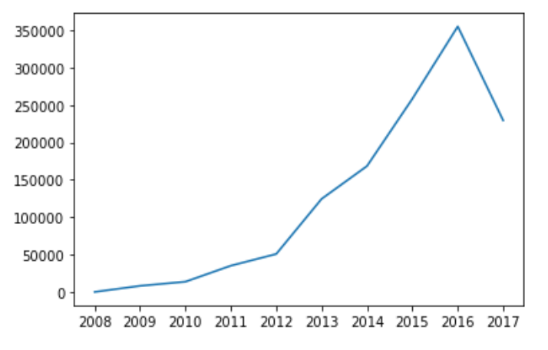
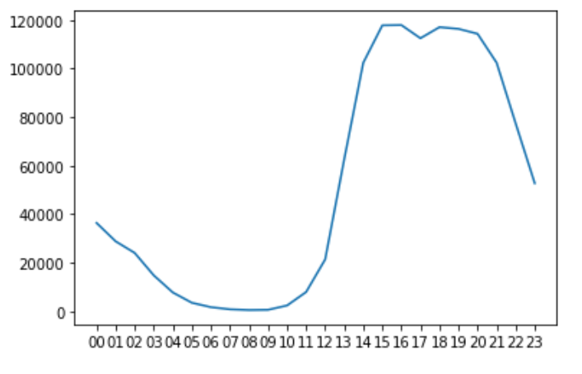
SECTION 5: Deeper Analysis
Tweets per Year Tweets per Hour

Slide 12
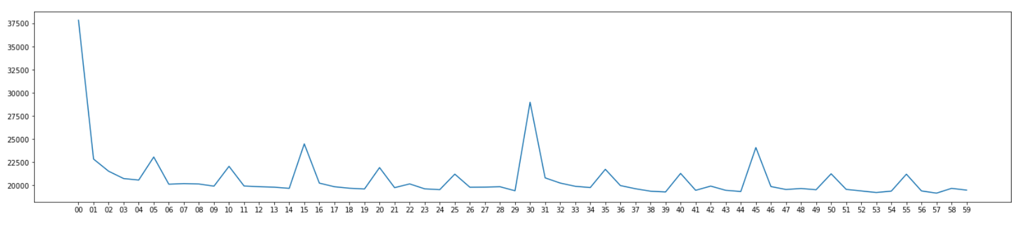
SECTION 5: Deeper Analysis
Tweets per Month

Slide 13
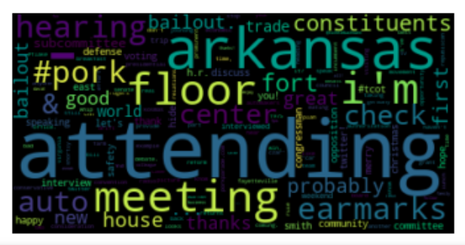
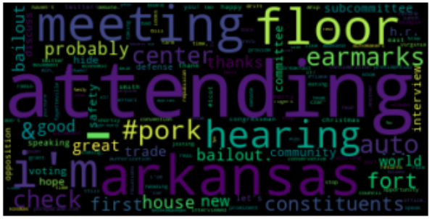
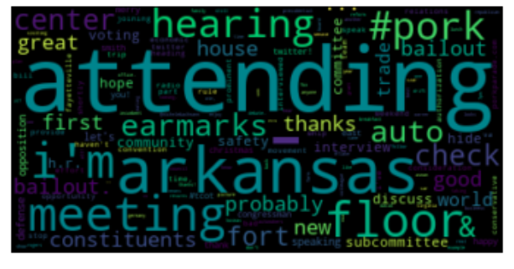
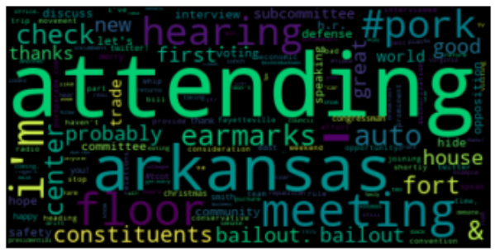
SECTION 5: Deeper Analysis
2017
2015
2016
2014
Attending
#pork
#meeting
Bailout
Seem the be the biggest topics discussed.

Slide 14
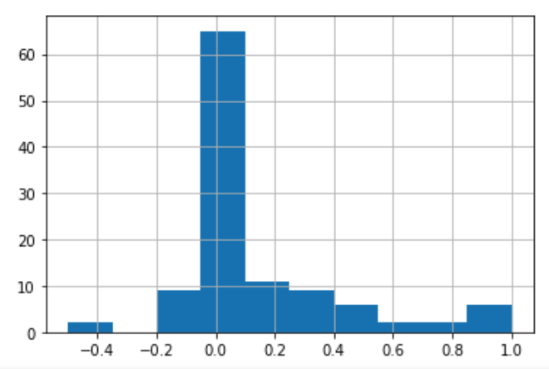
SECTION 5: Deeper Analysis
Sentiment is neutral slightly lining towards possitive.
Quite a lot of possitive tweets.
Surprisingly not many negative sentiment tweets with lowest value near -0.4.

Slide 15



SECTION 6: Hypothesis Results
Most likely the top influential person for the last few years is Donald Trump
This was true as seen on the number of RTs and mentions he obtained.
I believe the topics they will discuss the most are immigration and economy.
Topics hypothesis was wrong. Main discussions where about attending events and Arkansas.
The sentiment will be neutral for the most part with some negative skew to the negative.
This is primarily true however, it was noticeable to see that that there were not a significant amount of negative tweets which I was expecting.

